Slide 1
THE LARCAN 1500 WATT AMPLIFIER FOR 222 MHZ
David Olean K1WHS
Windsor Locks CT. April 14, 2023

Slide 2
Cheap QRO power on 222 MHz
What you get
The Pallet needs no conversion work. 16 dB Gain
Power output is 1500 watts. 50 VDC. 70 A. power needed.
Drive Requirements are in the 40 watt range.
What you need
Power Requirements 50 VDC at 65 amps
LP Filter is needed on the output.
Some forced air is needed for the heatsink.
Added protection Circuits
Eliminate Input Power Spikes
How to do it.

Slide 3
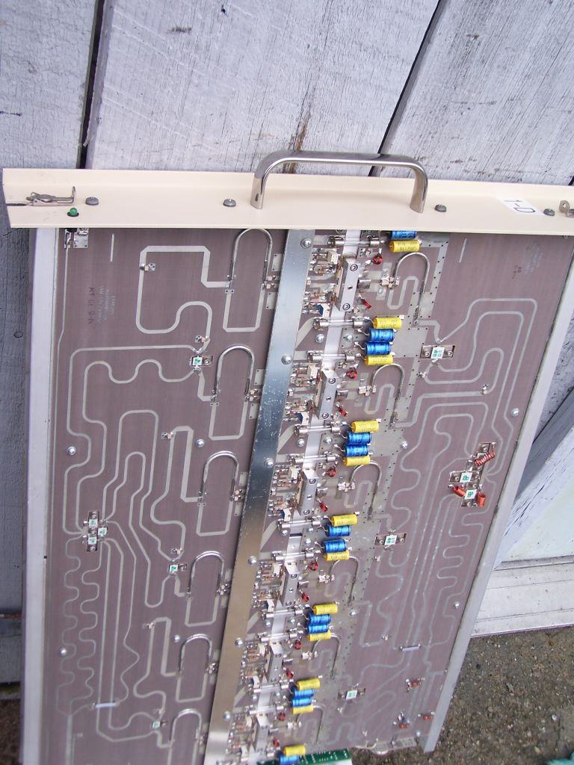
What does it look like?

Slide 4
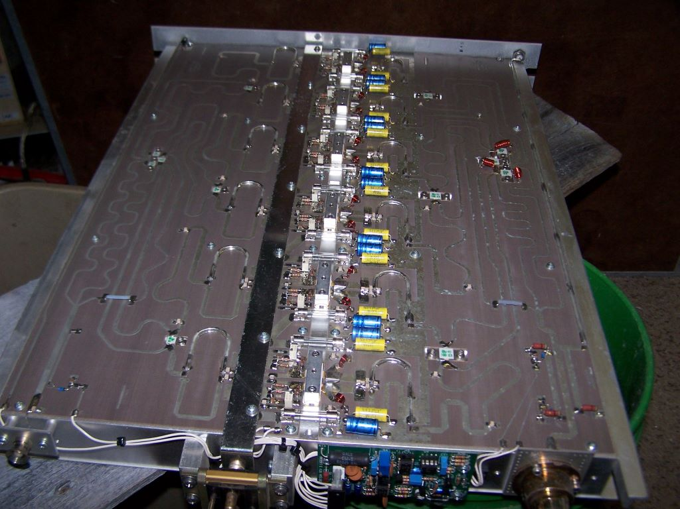
Six MRF-151G FETS in parallel 300 watts@ 175 MHz 16 dB gain at 222 MHz
Shape factor is very long and narrow. 23” deep.
Check out the W8ZN Amplifier mods in CSVHF Proceedings.

Slide 5
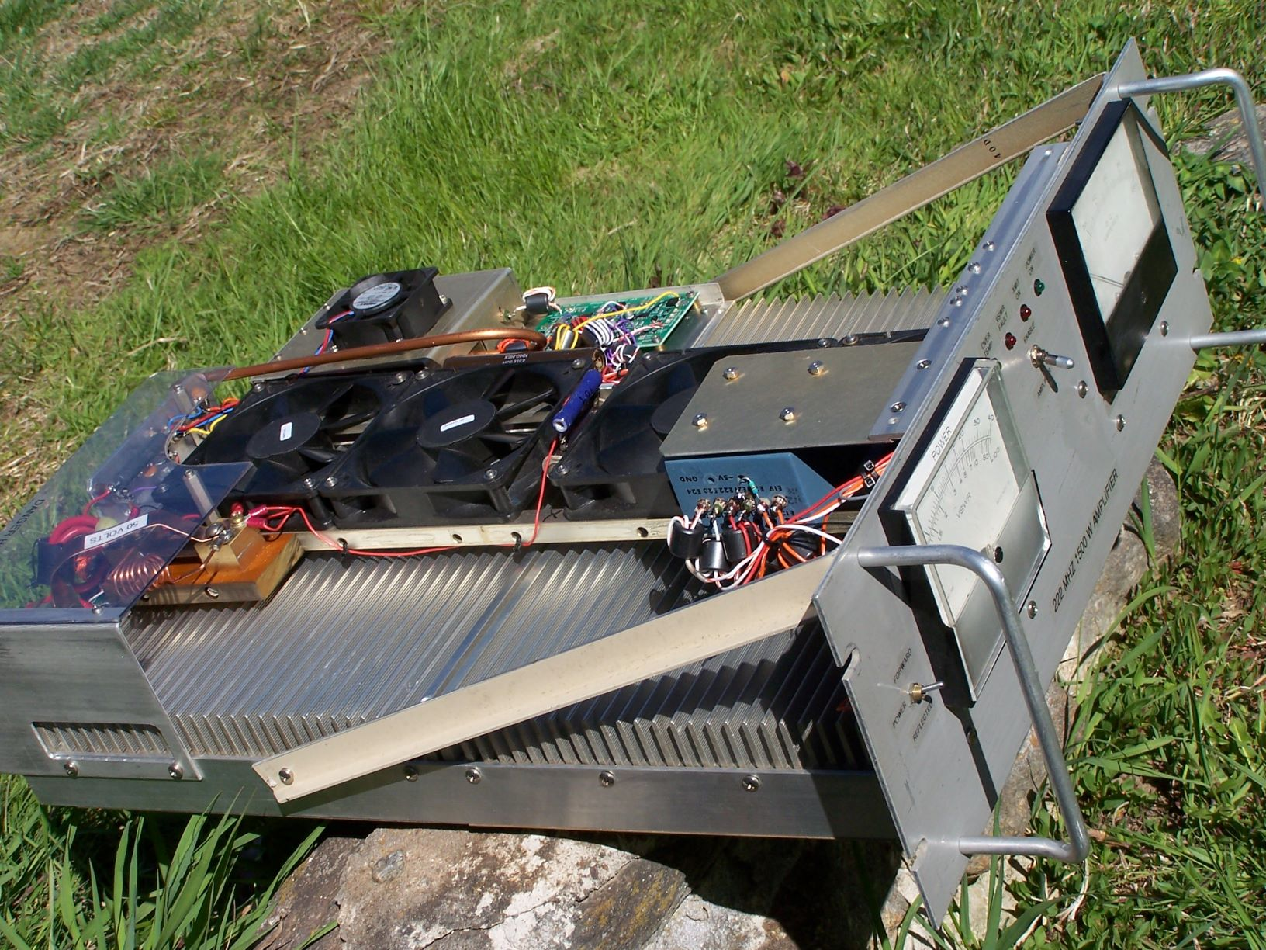
THE COMPLETED AMPLIFIER
Note front panel strengthening techniques
Heavy monitoring of circuit parameters.
Added protection circuits

Slide 6
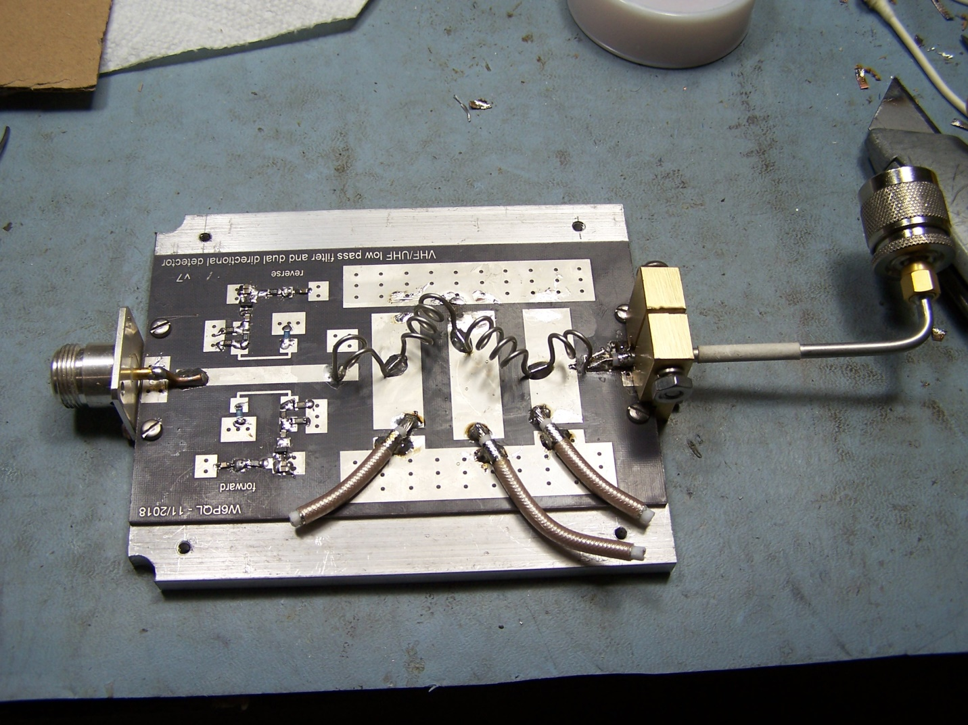
THE RF OUTPUT FILTER

Slide 7
THE W6PQL OUTPUT RF FILTER
2nd harmonic is typically 48 dB down.
Needs cooling air and high current caps.
Has a built in directional coupler for forward and reflected power.
Use the reflected power for VSWR fault ckt.
Insertion loss is under 0.1 dB
Could use bigger silver plated coil material.

Slide 8
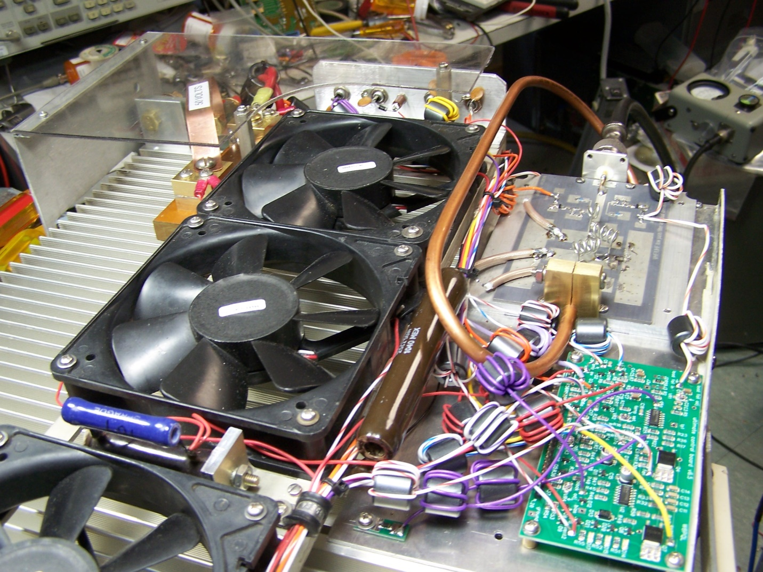
COOLING SYSTEM

Slide 9
COOLING SYSTEM
I use multiple muffin fans mounted on ½” aluminum angle stock, about an inch above the heatsink fins.
Four 12 volt fans in series at low RPM (QUIET)
Adjust a 10- 25 watt resistor for needed cooling.
Two fans at full power will work as well.

Slide 10
PROTECTION CIRCUITS
LARCAN Protection Board is already there
Provides VSWR protection and turns off bias
Allows for Hot Switching. (We don’t need that) The Hot Switching circuit needs a minor modification when we add our own VSWR protection circuit.
We will add a more robust protection circuit.

Slide 11
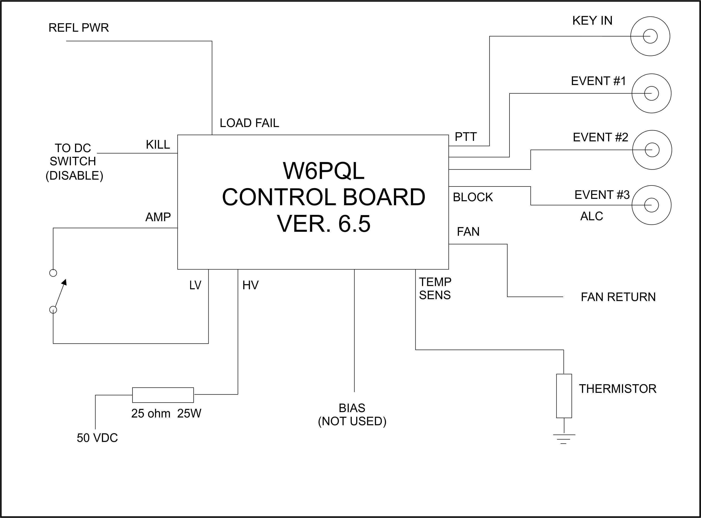
The heart of the system…W6PQL AMPLIFIER CONTROL BOARD

Slide 12
CONTROL BOARD FUNCTIONS
Provides sequencing function three levels 50 ms spacing
Fan Cooling Function with three levels of fan action
Has a temperature sensor mounted on the heat sink.
Will control a solid state FET relay to turn on 50 Volt power.
The FET DC switch also doubles as a VSWR shut down circuit.
The control board can operate off 12 volts or up to 50+ volts.
Enable Switch activates Control Board to switch in the amp.
VSWR protection using negative DC from directional coupler.
Sequenced Bias Control for FETS. (I did not use this function)
Wiring of these functions is rather simple. Good design!

Slide 14
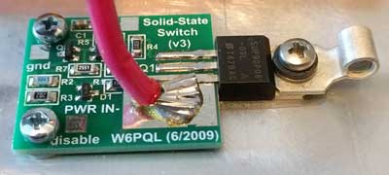
FET DC SWITCH
For the 1500 watt amplifier, you must add a second FET in parallel with the existing one. Easy to do but try to use the same date coded parts.
DC IN
DC OUT

Slide 15
INDICATOR LEDS PROVIDED
POWER ON Green LED single wire & gnd
Does not indicate AMP ENABLE.
TRANSMIT On Yellow LED single wire & gnd
VSWR FAULT Red LED single wire & gnd
HI TEMP FAULT Red LED isolated from
ground ( 2 wires from ckt board)

Slide 16
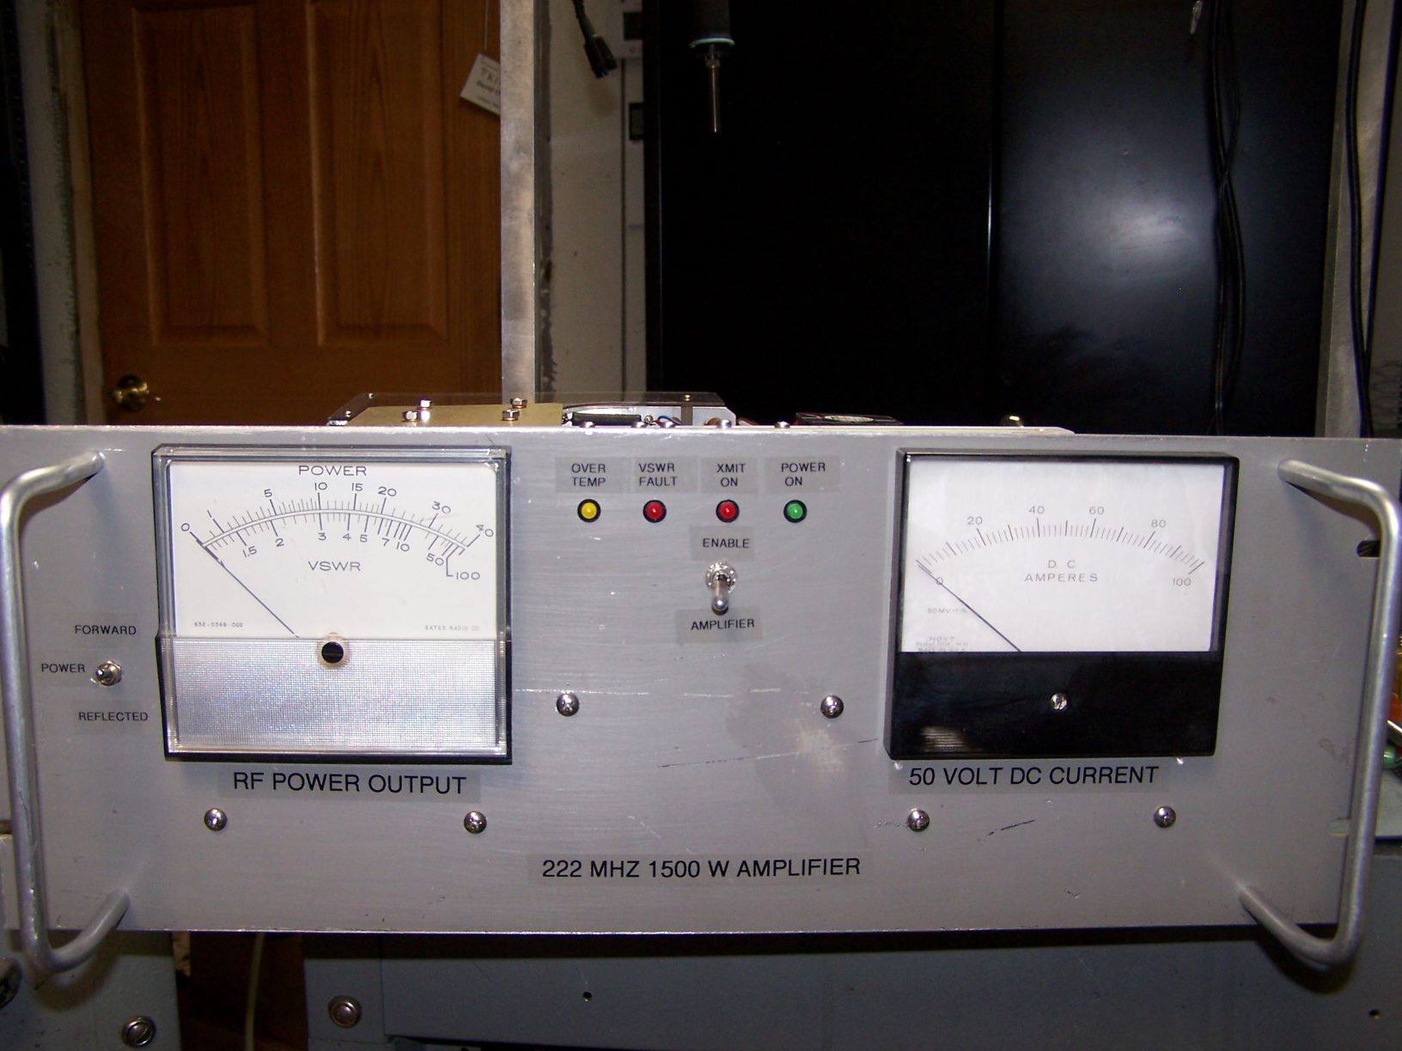
“Nice to Have” Additions
DC current indicator Old School vs New

Slide 17
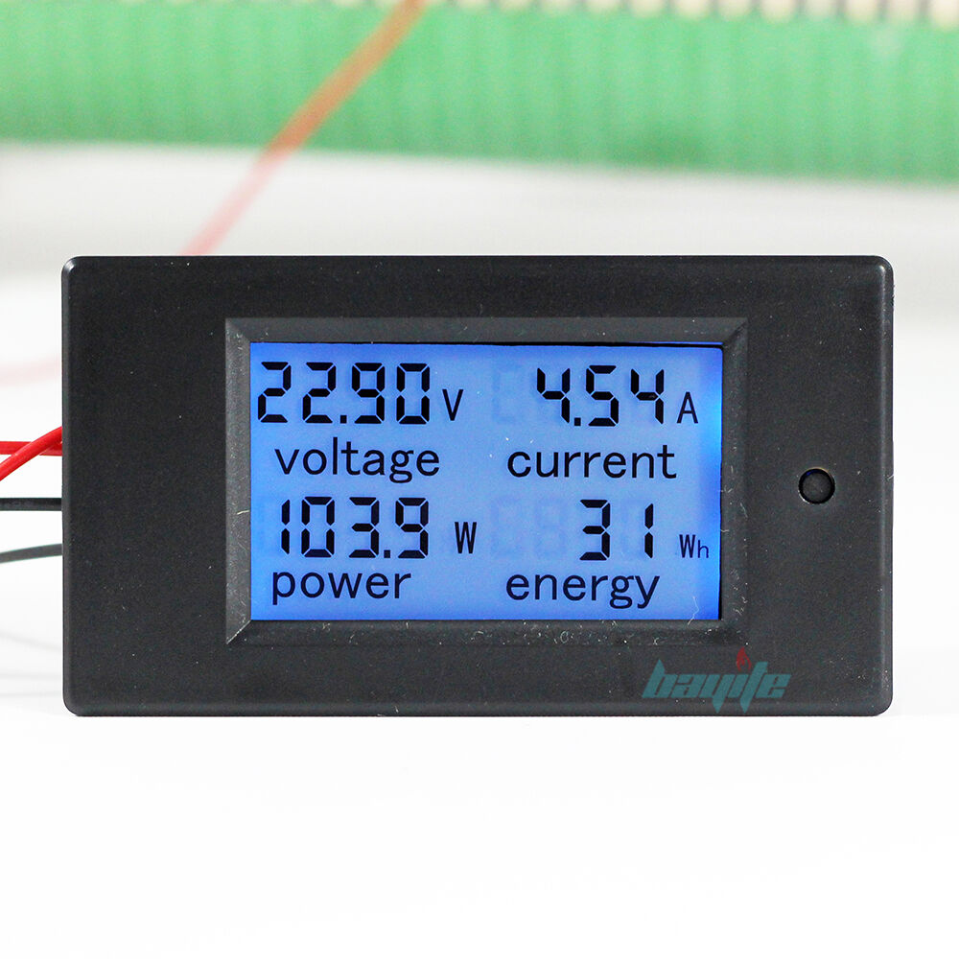
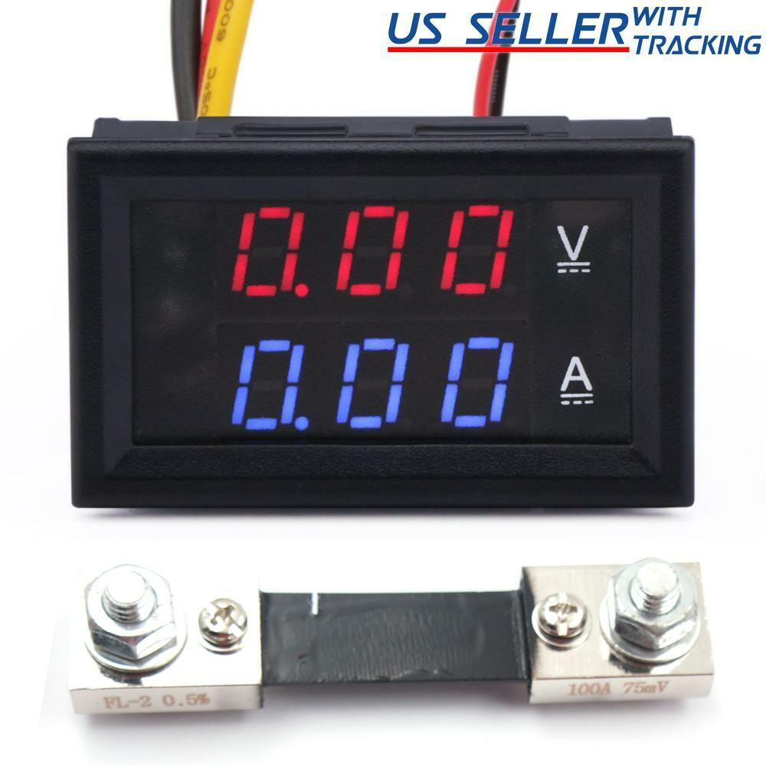
DC Current Indicators
Available on the internet at low money.
Digital readout in amperes.

Slide 18
OLD SCHOOL Ammeter Shunts
Most DC current meters utilize a 50 MV basic meter movement combined with a DC shunt resistor
You can make a homebrew meter shunt utilizing double clad PC board material
You can clone a real brass shunt with effort.
Find an old shunt and re cycle!

Slide 19
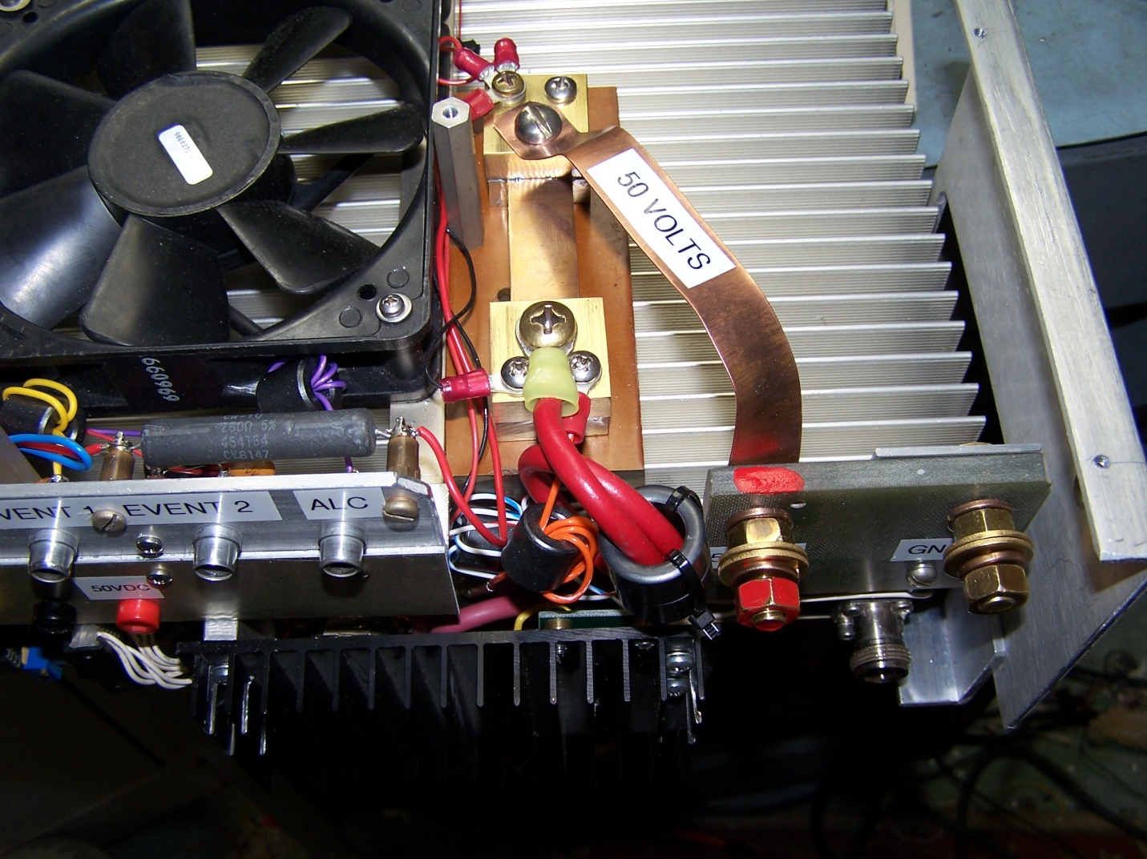
A Brass Homebrew Current Shunt

Slide 20
“Nice to Have” Additions
RF Output Indicator. Analog vs Digital
Analog meter can utilize the forward power signal from the output filter/directional coupler
Meter requires an OP AMP driver that must be well shielded to avoid RFI leakage errors.
Digital LED Indicator. Lower cost but might require filtering as well. (Use ferrites)

Slide 21
RF Output Meter
Fwd/ Refl Switch

Slide 22
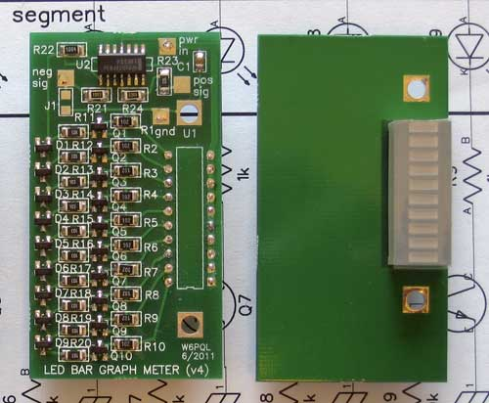
W6PQL BAR GRAPH “METER”
Available in kit form from W6PQL
This kit has an OP AMP built in for negative and positive inputs.
Bar Graph LEDs mount on front panel.

Slide 23
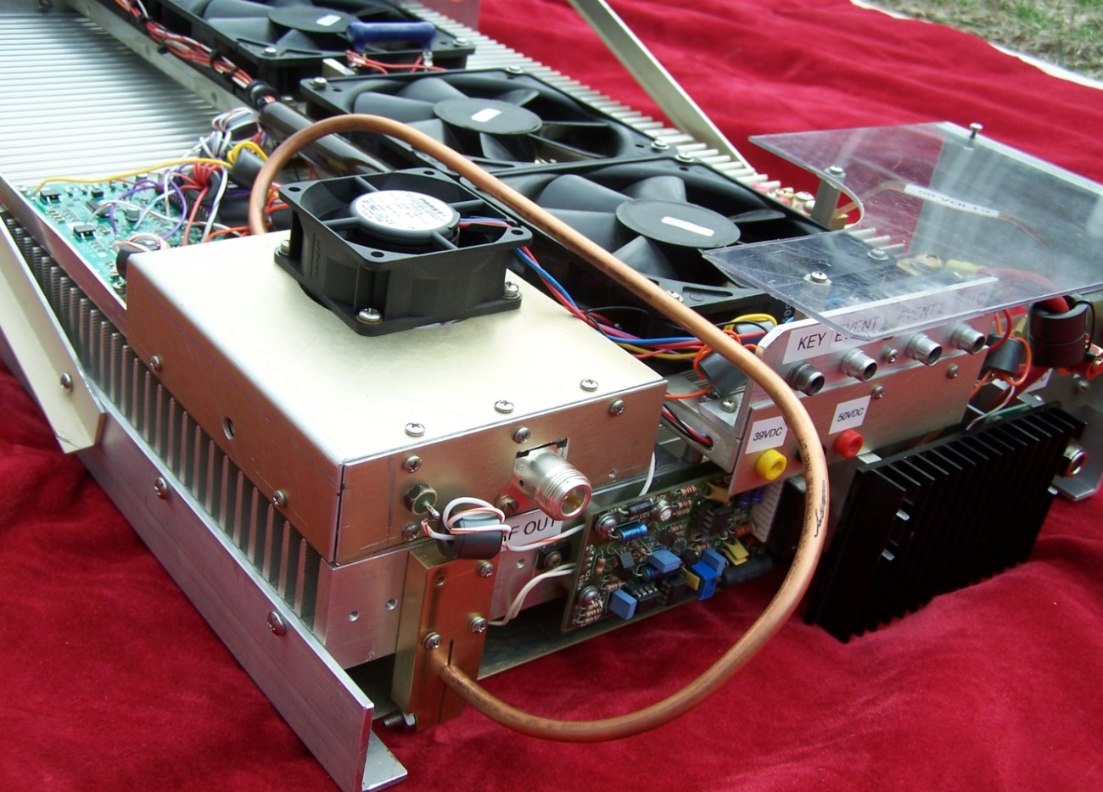
MEASUREMENT ADDITIONS
It is always nice to have all voltages available for measurement with little fuss.
Meter selector switch or Test Points

Slide 24
LIMIT EXCESSIVE INPUT POWER
Use driver amplifiers at full power
Insert attenuator to adjust for the required 40 or 50 watts maximum.
Do not attenuate before the driver. You want to prevent excessive RF spikes on turn on or shut off.
High power RF attenuator resistors are available on line.

Slide 25
IN SUMMARY
The LARCAN amp is a conservative, low cost way to achieve QRO on the 222 MHz band.
Minimal changes required.
It can be as simple or as complex as you or your pocketbook can provide.
At a minimum you want to have an effective filter and VSWR protection.
This system provides a reasonable solution.

